Slide 1

2 – DJ QUANTUM:
Nida Ajmi, Max Hunter Gordon, Artem Kislovskiy, Nicole Morgan, Soumya Shreeram, Manuel Morgado Vargas

Slide 2
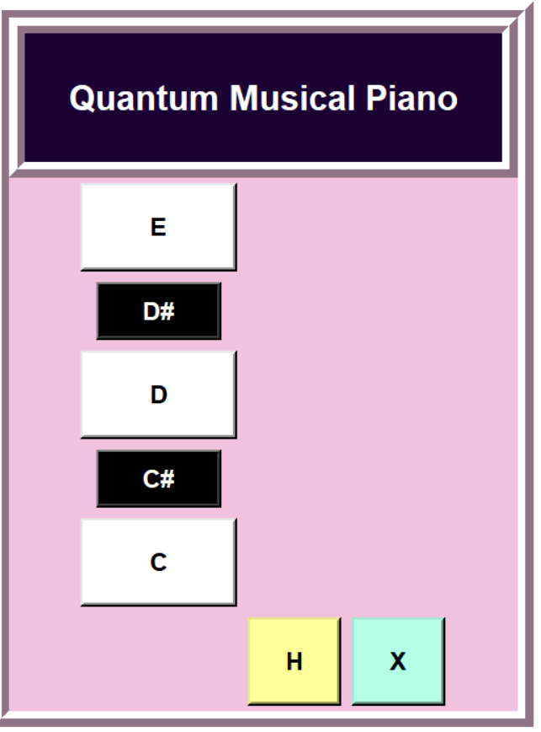
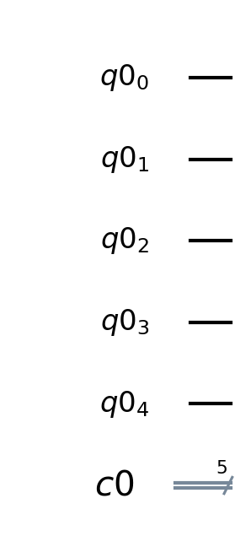

Slide 3
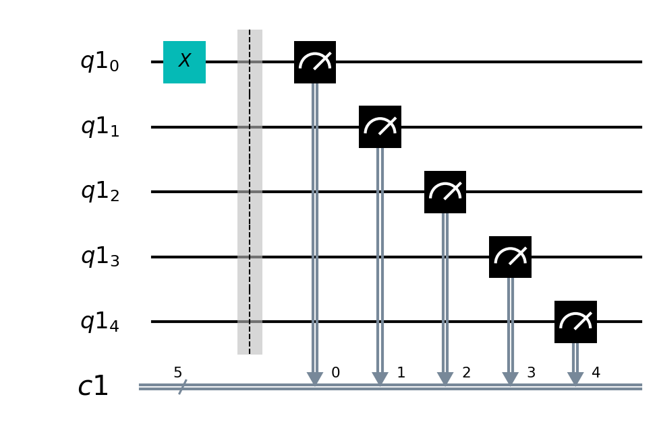

Slide 4
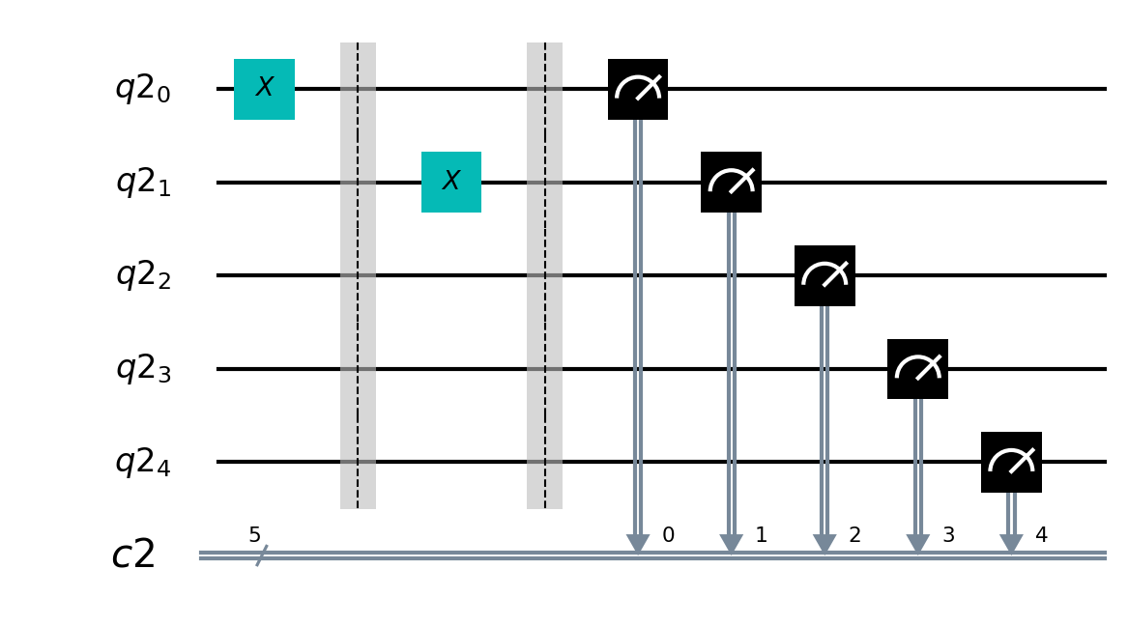

Slide 5
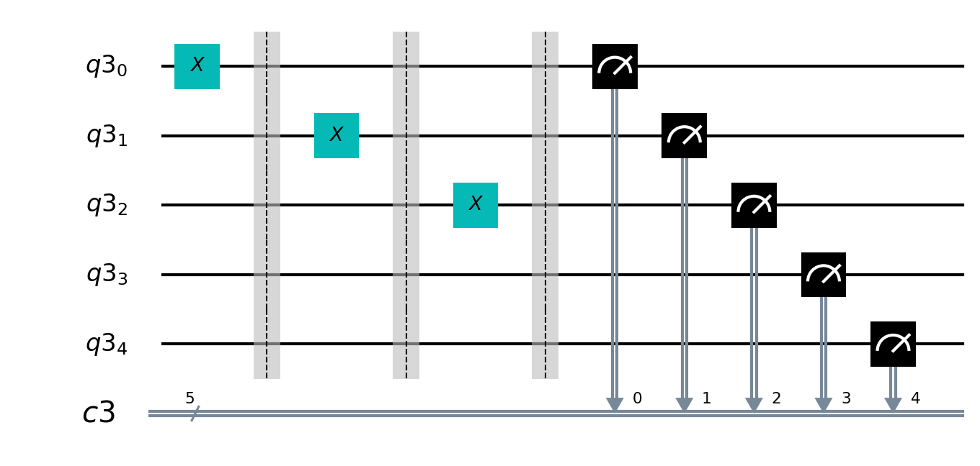

Slide 6
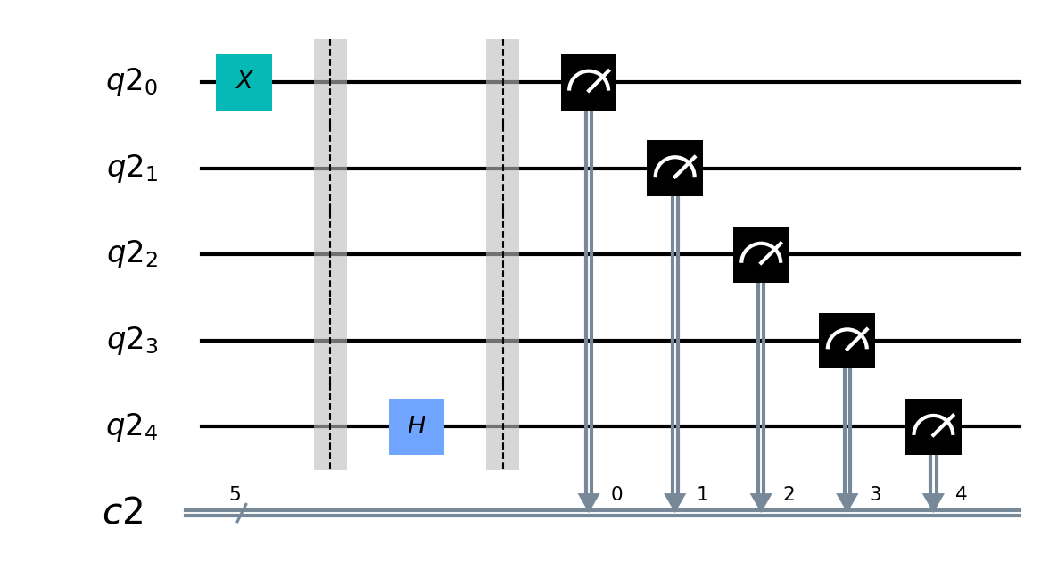

Slide 7
Thank you!
https://github.com/SoumyaShreeram/QFHackathon

